Slide 1
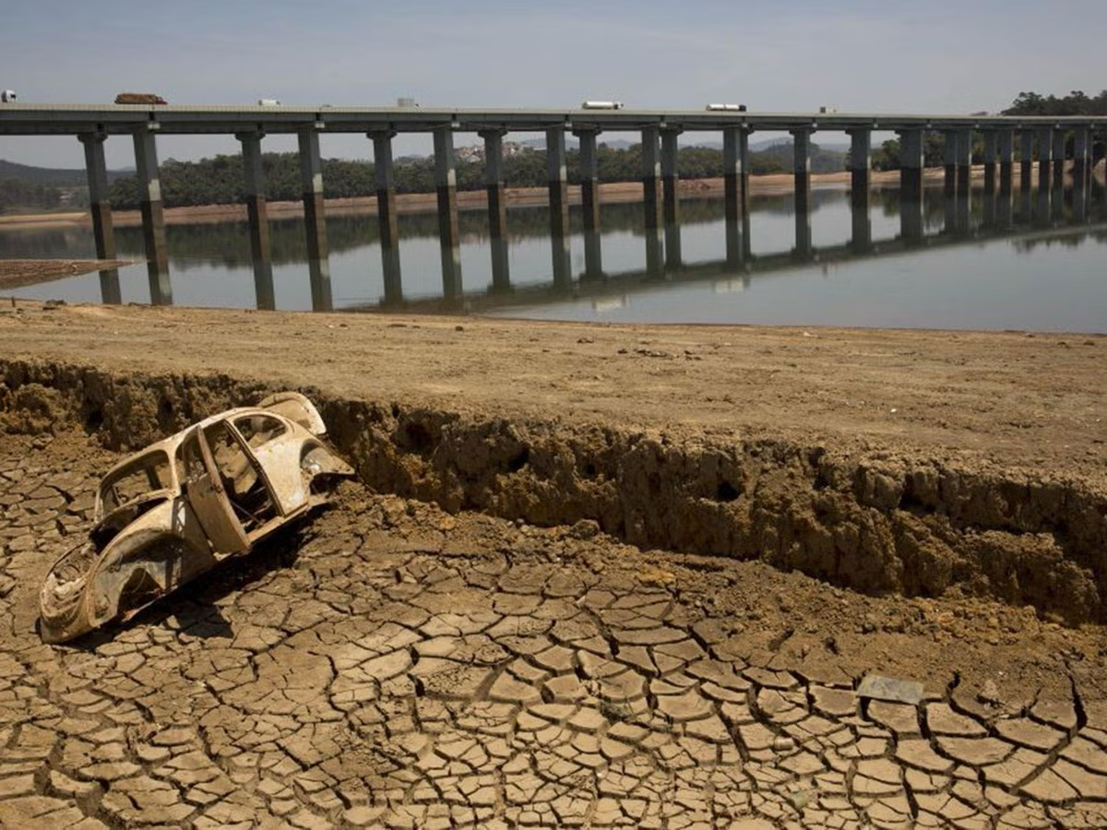

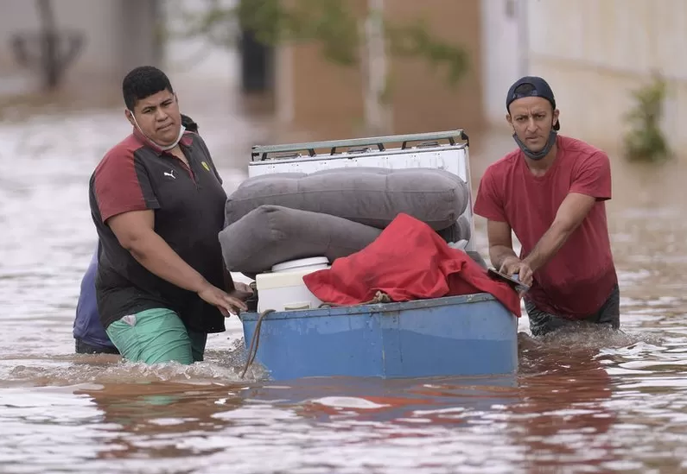
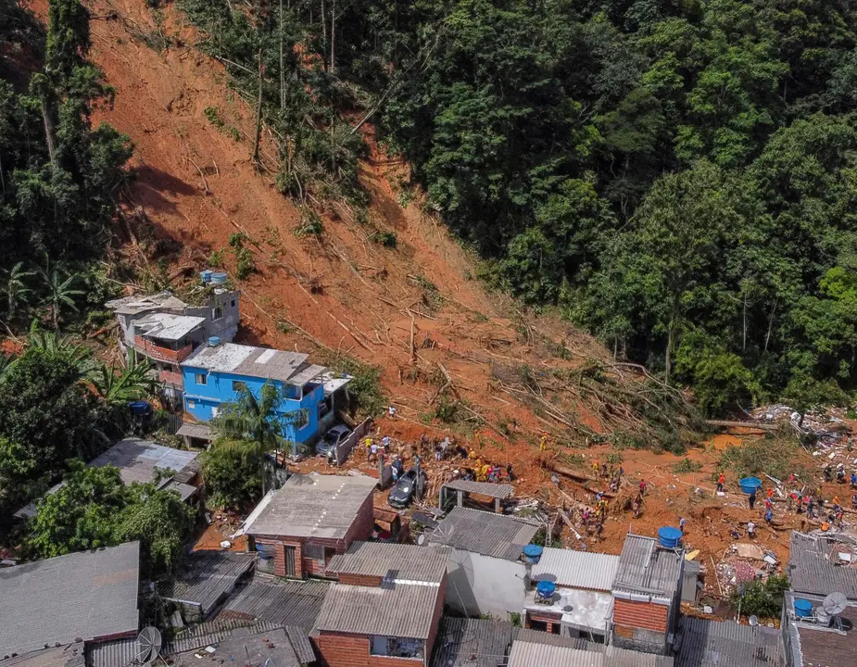


Public perceptions of human habitability in Brazil.
Presented by Srishtee Sinha.
19/01/2024
CSSP Brazil

Slide 2






About me.
BE Instrumentation Engineering
University of Mumbai
2012 to 2016
IT Analyst
Tata Consultancy Services
2017 to 2022
MSc. Business Analytics and Decision Sciences
University of Leeds
2022 to 2023

Slide 3


Agenda.
Background
Research objective
Methods
Results
Insights
Recommendations
Questions
20 minutes

Slide 4

Human Habitability.
Suitability of an environment to support human life.

Slide 5
Background
Maximum Wet-bulb temperature of 35-degree C and in humid regions it drops to 25-degree C.
Currently 1% of earth is uninhabitable. By 2050, 20% of earth will become uninhabitable.
Does the lay person understand the risks of migration due to climate change?
Notes:
The maximum wet-bulb temperature to support human life is 35-degree Celsius (95-degree Fahrenheit) which may drop to 25-degree Celsius (77-degree Fahrenheit) in humid regions and prolonged exposure to such high temperatures can cause death by hyperthermia (Earth Institute at Columbia University, 2020; Buis, 2022).
Recent IPCC report predicts several places that will become uninhabitable for humans by 2050, including Brazil.

Slide 6
Background
Several studies have shown a gap between acceptance and action – people don’t know what to do?
Paradoxical behaviour of people is explained by psychometric paradigm of risk where people tend to trade the climatic risks prevalent in an area with other gains like income, transfer of responsibility of action to someone else and a lack of resources.
Thus, there is a need to understand the public perception through stakeholder engagement and create informed Climate Risk Narratives to educate the public.
Notes:
The maximum wet-bulb temperature to support human life is 35-degree Celsius (95-degree Fahrenheit) which may drop to 25-degree Celsius (77-degree Fahrenheit) in humid regions and prolonged exposure to such high temperatures can cause death by hyperthermia (Earth Institute at Columbia University, 2020; Buis, 2022).
Recent IPCC report predicts several places that will become uninhabitable for humans by 2050, including Brazil.

Slide 7
Exploring the limits of human habitability in Brazil and using stakeholder engagement to inform the development of Climate Risk Narratives.
Objective: To elicit the key drivers of human habitability from a Brazilian public perspective and identify key weather and climate influences on human habitability in Brazil.
The following research questions were studied:
What factors affect the willingness to live in terms of human habitability for Brazilians?
What factors affect the willingness to leave in terms of human habitability for Brazilians?
What people think could improve human habitability in Brazil?

Slide 8
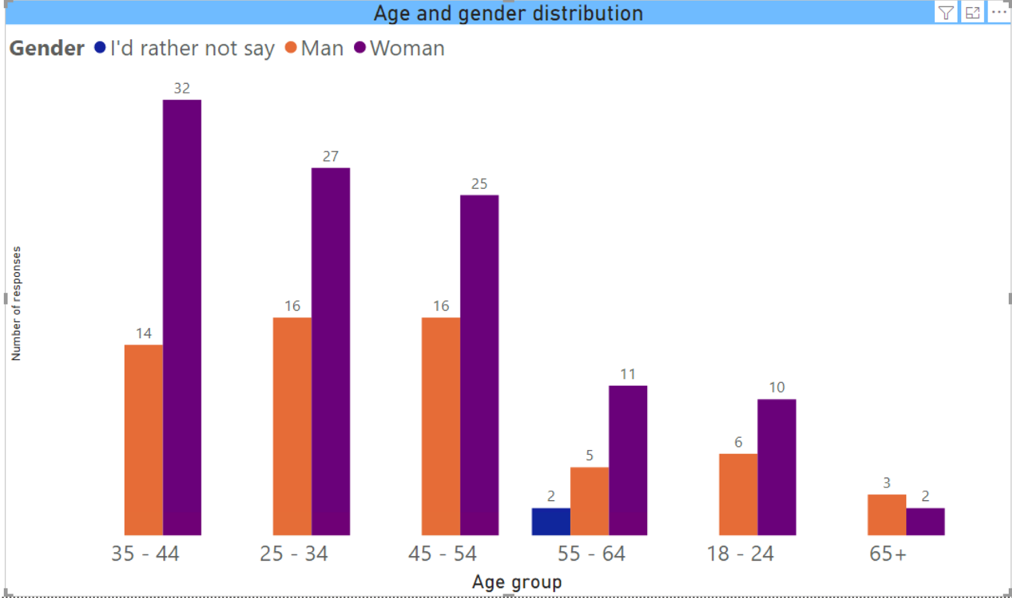
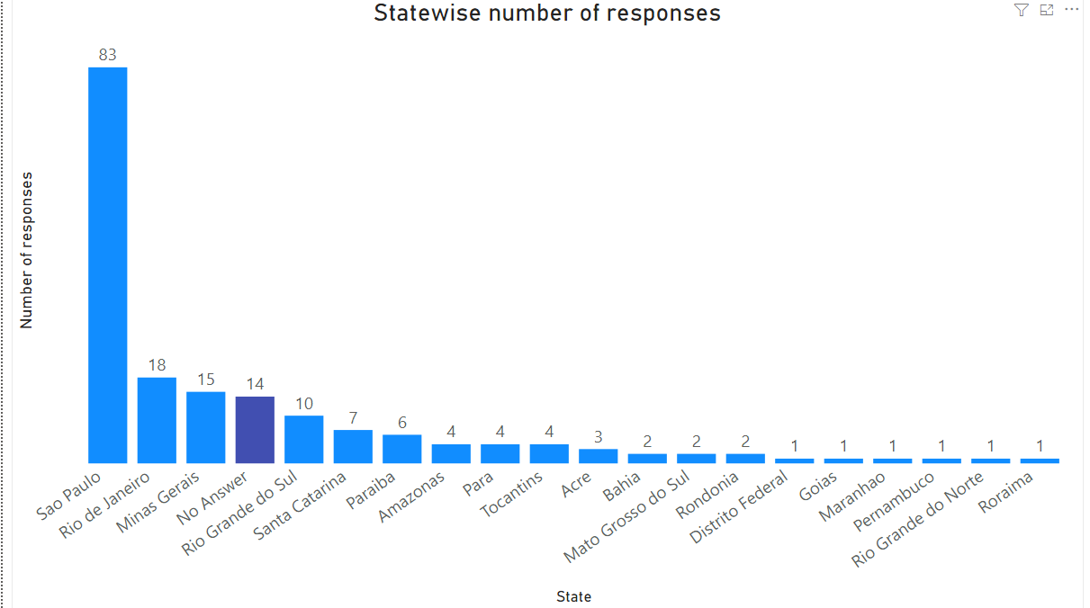
Data.
178 responses
17 States
Most in 25-54 years age group
63.3% Females

Slide 9
Methods.
25 Factors
5 logically coherent groups
Willingness to live scores
Willingness to leave scores
Online survey responses
17 states
Zone 1 – Sao Paulo
Zone 2 – Rio De Janeiro
Zone 3 – Minas Gerais
Zone 4 – Rest of Brazil
Zone 5 – Overall Brazil
PCA
Quantitative Analysis
ANOVA
Linear Regression
Qualitative Analysis
Thematic Analysis
Sentiment analysis
Paired samples t-tests

Slide 10






Results.

Slide 11
Variable reduction.
Willingness to leave for fast onset climatic events. | Willingness to leave for slow onset climatic events. | Willingness to Live for fast onset climatic events. | Willingness to live for slow onset climatic events. | Willingness to leave for non-climatic factors.
Too many extreme weather conditions | Bad air quality | Flooding | Drought | No Jobs
River flooding | Too hot | Landslides | Intense rainfall | Not safe
Flash flooding | Too dry | Wildfires | Heatwaves | No health service
Storm surge | Too wet |  | Windstorms | Negative political situation
Landslides | Windstorms |  | Low air humidity
Wildfires | Cold spell
 | Low air humidity

Slide 12
Key Drivers - overall.
Willingness to leave for fast onset climatic events. | Willingness to leave for slow onset climatic events. | Willingness to Live for fast onset climatic events. | Willingness to live for slow onset climatic events. | Willingness to leave for non-climatic factors.
Too many extreme weather conditions | Bad air quality | Flooding (0.872) | Drought | No Jobs
River flooding (0.819) | Too hot (0.870) | Landslides (0.907) | Intense rainfall | Not safe (0.866)
Flash flooding (0.882) | Too dry (0.896) | Wildfires | Heatwaves (0.778) | No health service (0.879)
Storm surge | Too wet |  | Windstorms | Negative political situation
Landslides (0.884) | Windstorms |  | Low air humidity (0.905)
Wildfires | Cold spell
 | Low air humidity (0.782)

Slide 13
Key Drivers - Sau Paulo.
 | Willingness to live for fast onset climatic events. | Willingness to leave for fast onset climatic events. | Willingness to live for slow onset climatic events. | Willingness to leave for slow onset climatic events. | Willingness to leave for non-climatic factors.
Key drivers (In descending order) | Flooding and Landslides | Flash flooding, river flooding, too many extreme weather events and landslides | Drought, Intense rainfall, windstorms, and Heatwaves | Bad air quality, Too Dry, Too Hot, Windstorms and low air humidity | No jobs, not safe and no health service
Wilk’s Lambda | 0.88 | 0.516 | 0.721 | 0.478 | 0.696
Significance | 0.007 | <0.001 | <0.001 | <0.001 | <0.001
Partial eta squared | 0.12 | 0.484 | 0.279 | 0.522 | 0.304
Effect of event type | Moderate | Large | Large | Large | Large

Slide 14
Key drivers – Rio De Janeiro.
Test for willingness to | Wilk’s Lambada | P-value | Significance | Partial eta squared (Effect) | Key drivers
Live fast onset | 0.899, (2,16) =0.901 | 0.426 | Insignificant | 0.101 | Flooding and landslides
Live slow onset | 0.631, (4,14) = 2.045 | 0.143 | Insignificant | 0.369 | Drought and intense rainfall
Leave fast onset | 0.414, (5,12) = 3.394 | 0.038 | Significant | 0.586 (Large) | Landslides, flash flooding and river flooding
Leave slow onset | 0.516, (6,12) = 1.873 | 0.167 | Insignificant | 0.484 | Bad air quality, too dry, too hot, and windstorms
Leave non-climatic | 0.901, (3,14) = 0.510 | 0.682 | Insignificant | 0.099 | No jobs

Slide 15
Key Drivers – Minas Gerais.
Test for willingness to | Wilk’s Lambada | P-value | Significance | Partial eta squared (Effect) | Key drivers
Live fast onset | 0.983, (2,12) =0.101 | 0.904 | Insignificant | 0.017 | Landslides and wildfires
Live slow onset | 0.481, (4,11) = 2.971 | 0.069 | Insignificant | 0.519 | Heatwaves and low air humidity
Leave fast onset | 0.105, (5,7) = 11.921 | 0.003 | Significant | 0.895 (Large) | Too many extreme weather conditions, landslides, and wildfires
Leave slow onset | 0.066, (6,6) = 14.090 | 0.003 | Significant (However, there were no significant differences in pairwise comparisons) | 0.934 (Large) | Bad air quality, too hot, and too dry
Leave non-climatic | 0.273, (3,9) = 7.975 | 0.007 | Significant | 0.727 (Large) | No jobs and no health service

Slide 16
Key Drivers – Rest of Brazil.
Test for willingness to | Wilk’s Lambada | P-value | Significance | Partial eta squared (Effect) | Key drivers
Live fast onset | 0.993, (2,48) =0.166 | 0.847 | Insignificant | 0.007 | Landslides and flooding
Live slow onset | 0.914, (4,46) = 1.088 | 0.374 | Insignificant | 0.086 | Drought and heatwaves
Leave fast onset | 0.567, (5,40) = 6.099 | <0.001 | Significant | 0.433 (Large) | Too many extreme weather conditions, flash flooding, wildfires, river flooding, and landslides
Leave slow onset | 0.497, (6,39) = 6.585 | <0.001 | Significant (However, there were no significant differences in pairwise comparisons) | 0.503 (Large) | Bad air quality, too hot, too dry and windstorms
Leave non-climatic | 0.666, (3,45) = 7.537 | <0.001 | Significant | 0.334 (Large) | No jobs and no health service

Slide 17

Insights.

Slide 18
Non-climatic factors are greatly considered while relocation.
Non-climatic factors
Health service, safety.
Fast-onset climatic factors
Floods, Landslides
Slow-onset climatic factors
Too hot, Too cold
Fast-onset climatic factors
Slow-onset climatic factors

Slide 19
Daily travel and willingness to leave are related.
Linear regressions were performed to analyse what factors define the willingness to leave for Brazilians. The results show that Impact to the activities of going to School/University/Work significantly explain the willingness to leave for non-climatic factors (21.6%), fast onset climatic factors (22.9%) and slow onset climatic factors (16.3%). Thus, there is a relationship between disruption of commutation to school/university/work and people’s choices of living or leaving an area.

Slide 20

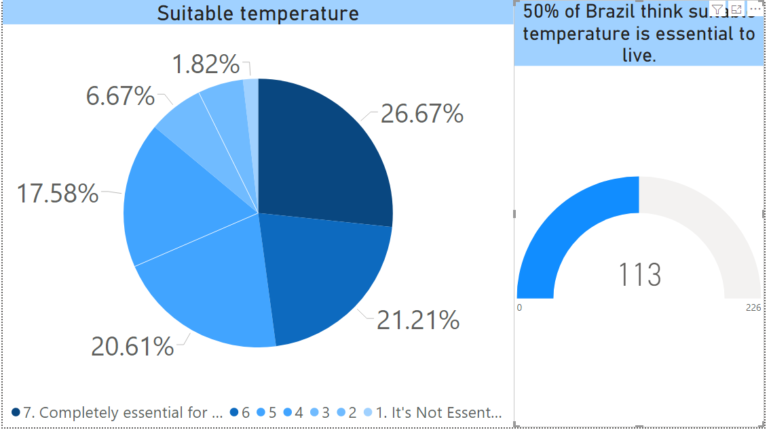



People consider suitable temperature essential to live but will they relocate if its too hot or too cold?

Slide 21
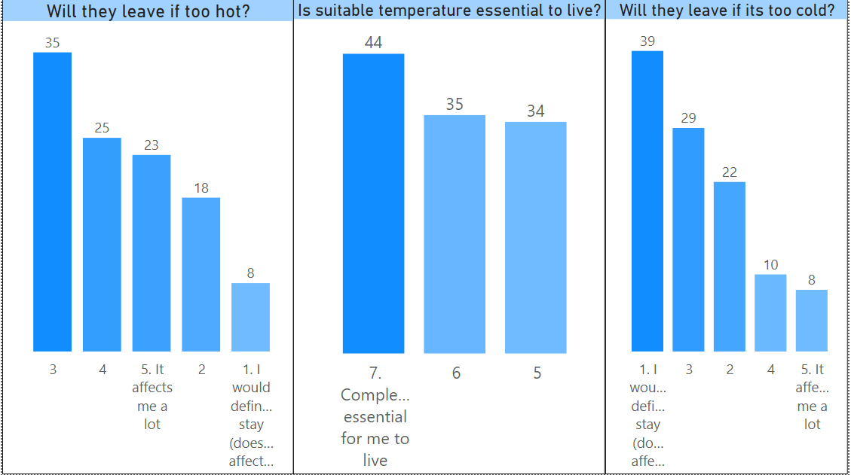
But people might leave if its too hot but not cold.

Slide 22
People are reluctant to leave an area for the same factors that they consider important to live.
Zone |  | 1 | 2 | 3 | 4 | 5
Sample size (N) |  | 75 | 18 | 12 | 49 | 154
States |  | Sau Paulo | Rio de Janeiro | Minas Gerais | Rest of Brazil | Overall Brazil
Fast onset climatic events | Willingness to live | M=0.8128, SD=0.25038 | M=0.8429, SD=0.21402 | M=0.6898, SD=0.28472 | M=0.7560, SD=0.26183 | M=0.7890, SD=0.24764
 | Willingness to leave | M=0.6228, SD=0.25754 | M=0.7498, SD=0.20938 | M=0.6146, SD=23440 | M=0.5849, SD=0.24263 | M=0.6249, SD=0.24764
 | Mean difference | 0.18995 | 0.09310 | 0.0752 | 0.17112 | 0.16416
 | T(N-1) | 7.210 | 3.920 | 1.048 | 5.501 | 9.437
 | 2-tailed Sig(p) | <0.001 | =0.001 | =0.317 | <0.001 | <0.001
 | 95% CI Range | 0.13746 to 0.24244 | 0.07745 to 0.24373 | -0.08275 to 0.23305 | 0.10857 to 0.23367 | 0.12979 to 0.19852
 | Eta squared statistic | 0.4126 | 0.4748 | - | 0.3866 | 0.3664
 | Effect | Large | Large | - | Large | Large
Slow onset climatic events | Willingness to live | M=0.6378, SD=0.23504 | M=0.6915, SD=0.24225 | M=0.6046, SD=0.22704 | M=0.6421, SD=0.24263 | M=0.632844, SD=0.241564
 | Willingness to leave | M=0.5577, SD=0.22322 | M=0.5309, SD=0.23158 | M=0.4945, SD=0.24103 | M=0.5248, SD=0.21852 | M=0.530608, SD=0.23032
 | Mean difference | 0.8012 | 0.16059 | 0.11004 | 0.11725 | 0.1022356
 | T(N-1) | 3.615 | 4.075 | 1.725 | 4.161 | 6.684
 | 2-tailed Sig(p) | <0.001 | <0.001 | =0.108 | <0.001 | <0.001
 | 95% CI Range | 0.03595 to 0.12428 | 0.07745 to 0.24373 | -0.02774 to 0.24783 | 0.6060 to 0.17390 | 0.06872 to 0.12981
 | Eta squared statistic | 0.1501 | 0.4941 | - | 0.2651 | 0.2111
 | Effect | Large | Large | - | Large | Large

Slide 23
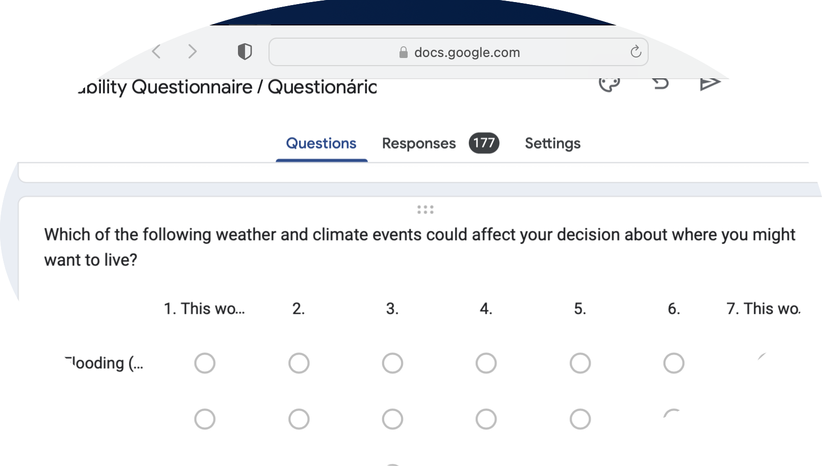
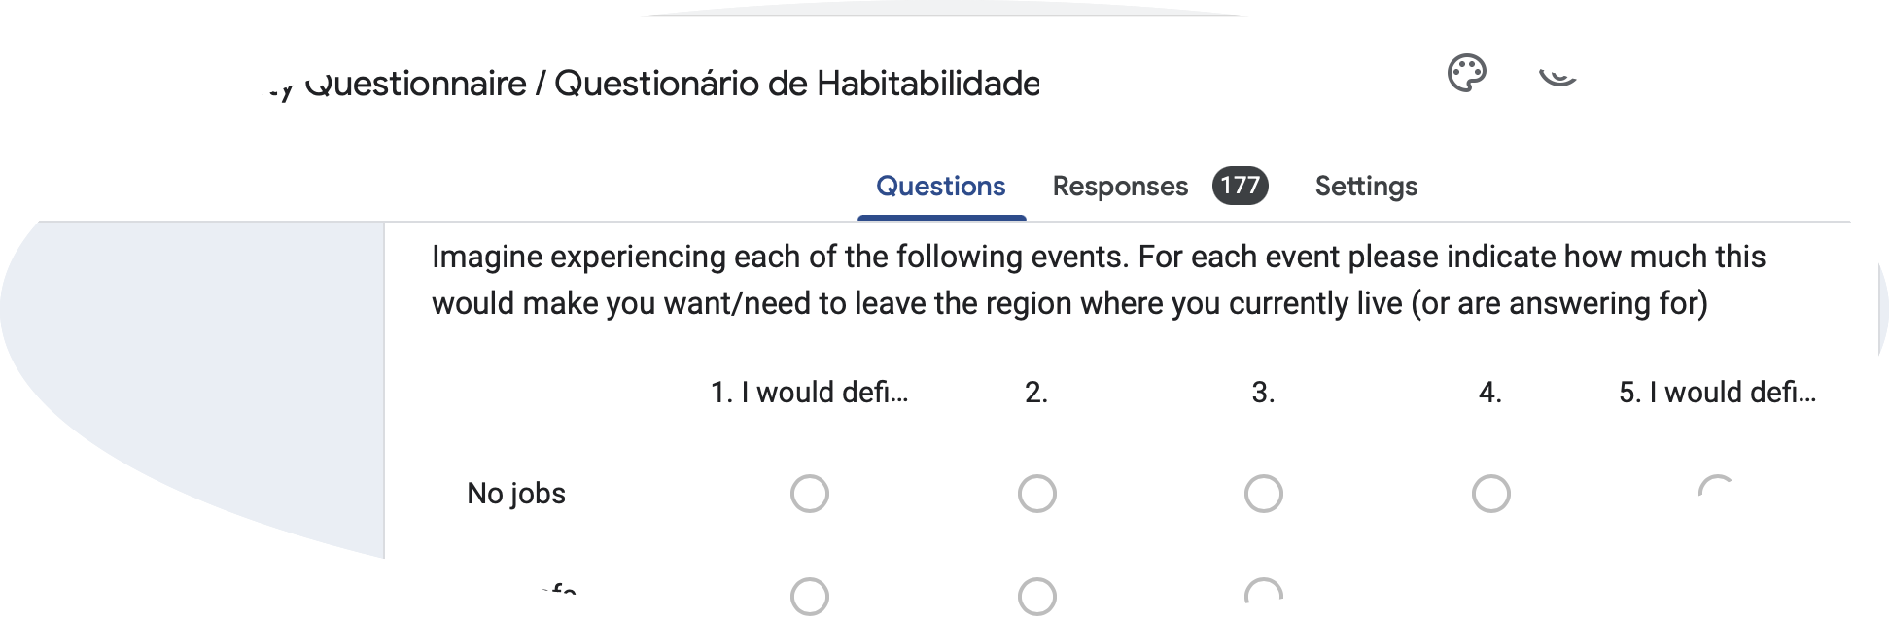
Reason-based choice.
Liberal!
Conservative!

Slide 24


Endowment effect.
£
£
£
MINE
NOT MINE

Slide 25

Essentials to thrive.

Slide 26
What can improve habitability?
Themes | Counts | Improvements suggested
Public transportation/mobility | 41 | Better public transport is needed, including more options, affordability, and connectivity.
Sanitation/Sewage/Waste management | 25 | Sewage treatment, drainage systems, and waste management are lacking.
Healthcare/Health services | 22 | More facilities, better equipment, more coverage, and specialized care are needed.
Infrastructure/Roads/Housing | 19 | Paving, asphalt, drainage issues were flagged.
Environment/Air quality/Water quality | 17 | Reducing fires and deforestation was suggested.
Safety/Security | 14 | Crime prevention and more personnel needed.
Education/Schools | 10 | Better quality and access emphasized.
Public policies/Governance | 9 | Effective management and enforcement of laws needed.
Leisure/Culture/Parks | 9 | More public spaces for recreation desired.
Employment/Jobs | 8 | More opportunities locally.
Urban heat mitigation. | 7 | Afforestation/Trees/Green spaces
Technology/Internet | 2 | Access to internet/technology

Slide 27
Best and worst futures.
Best case themes
Themes | Counts
Reforestation/green spaces | 29
Clean water access | 21
Infrastructure adaptation/resilience | 19
Temperature moderation | 9
Social equality | 6
Forest preservation | 6
Education/awareness | 4
Worst case themes
Themes | Counts
Water scarcity/drought | 34
High temperatures/heat waves | 29
Floods/landslides | 24
Fires/burning | 20
Air pollution | 11
Food scarcity/hunger | 10
Poverty/inequality | 10
Displacement/migration | 6
Sea level rise | 4
Disease | 4

Slide 28
Recommendations.
Connect climate change to jobs, health or fatality.
Use subjective scenarios.
Depict favorable future with cleaner water, afforestation and moderate temperatures.
Personal stories indicating impact to travel for work/school/university.
Associate floods, drainage and climate change.
Notes:
Interconnectedness: The people of Brazil are not prominently concerned about the climatic events that might displace them in future. Instead, they consider employment and health as most essential for habitability. Hence, linking climate change with impacts to jobs or health or fatality might reinforce the importance of suitable climate for habitability.
FRACTAL emphasizes on subjective and contextual messaging instead of overwhelming data to avoid confusion and enhance receptivity of the message (Scott & Taylor, 2019). Thus, illustrating the impacts in subjective scenarios would be better than quoting data.
Positive message: The imaginary future for the Brazilians is not completely pessimistic, thus indicating hope for a better environment with afforestation, access to clean water and temperature moderation. It might help to demonstrate how the suggested improvement measures can lead to a favorable future with cleaner water or temperature moderation, etc. Moreover, studies have established that fearful messages may attract attention, but fear is ineffective in motivating individual engagement (O’Neill & Nicholson-Cole, 2009).
Human stories: Including anecdotes or personal stories indicating impact to daily life activities such as travel to school/work/universities might increase climate change awareness as it is seen that people are likely to leave an area if their travel to school/work/university is affected (Global Network of Civil Society Organization for Disaster Reduction, 2023).
As people are most concerned about lack of clean water in future, it may be fruitful to suggest some measures that associate with cleaner water.
People are also concerned about drainage systems and show high willingness to live, and leave based on floods. Hence, it might be helpful to associate floods, drainage, and climate change.

Slide 29

Questions? Ask now.

Slide 30



Thank you.
+44 7767941445
sinhasrishtee@gmail.com
https://www.linkedin.com/in/srishtee-sinha-a6711a11a/

